Slide 1

Stock Trends ETL Process Sweet Trends: Ricky Lee | Henry Tirado | Vanessa Villagomez

Slide 2
Introduction
Curious about stock trends? We, the "Sweet Stocks," will be Extracting data from a reputable source and will Transform the data as best possible to Load structured data that will show specific stock trends.
As a way to guide our efforts, we've asked the following questions:
What are the stocks of most interest per specified regions?
Are trending stocks the most volatile stocks in the specified regions? Compare the 20 trending stocks vs. SYP (symbol tracks S&P 500 - tracks top 500 companies in the U.S.)
Among the 20 trending stocks, what is the average gain or loss "pre-covid" vs. "during covid"? ("Pre-covid Period" - March 2019 to March 2020 vs. "During Covid Period " – March 2020 to March 2021)

Slide 3
Sources and Platforms
Open Source Library: Yahoo_Fin
Jupyter Notebook
Pandas/Python
Requests
PostgreSQL

Slide 4
ETL Process
Extract
Retrieve list of trending stock tickers for 10 regions
Transform
Convert timestamp and startintervals to db readable formats
Load
Import extracted tables to Postgres
Pull detailed quote data for tickers identified
Find 10-year History (open/close/high/low/volume) of the tickers
Reduce quote data attributes to only those needed to answer our questions
Import reduced tables to Postgres

Slide 5
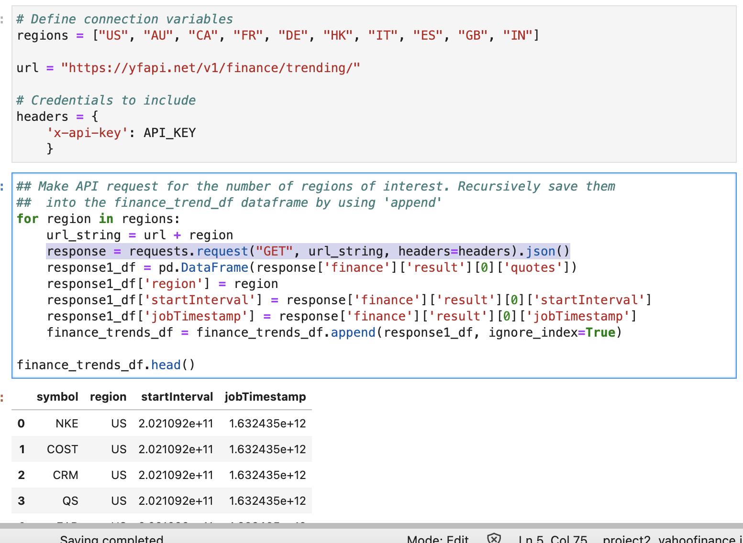
Extract Example: API to DataFrame

Slide 6
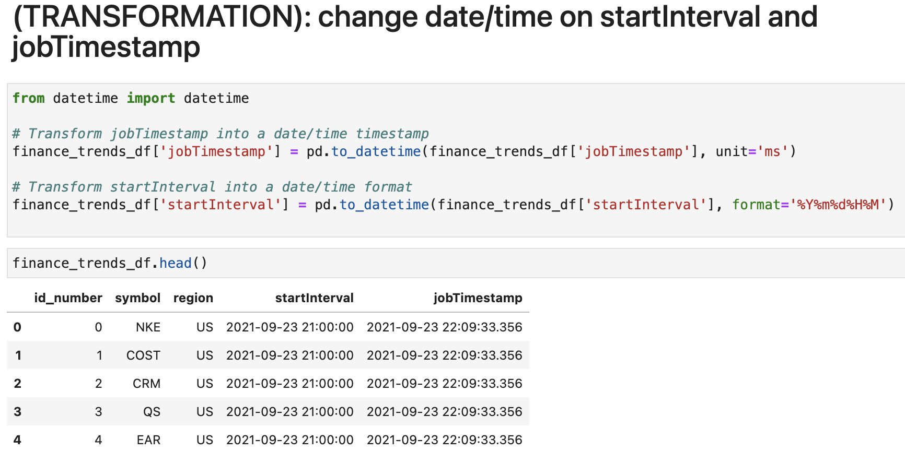
Transformation Example:

Slide 7
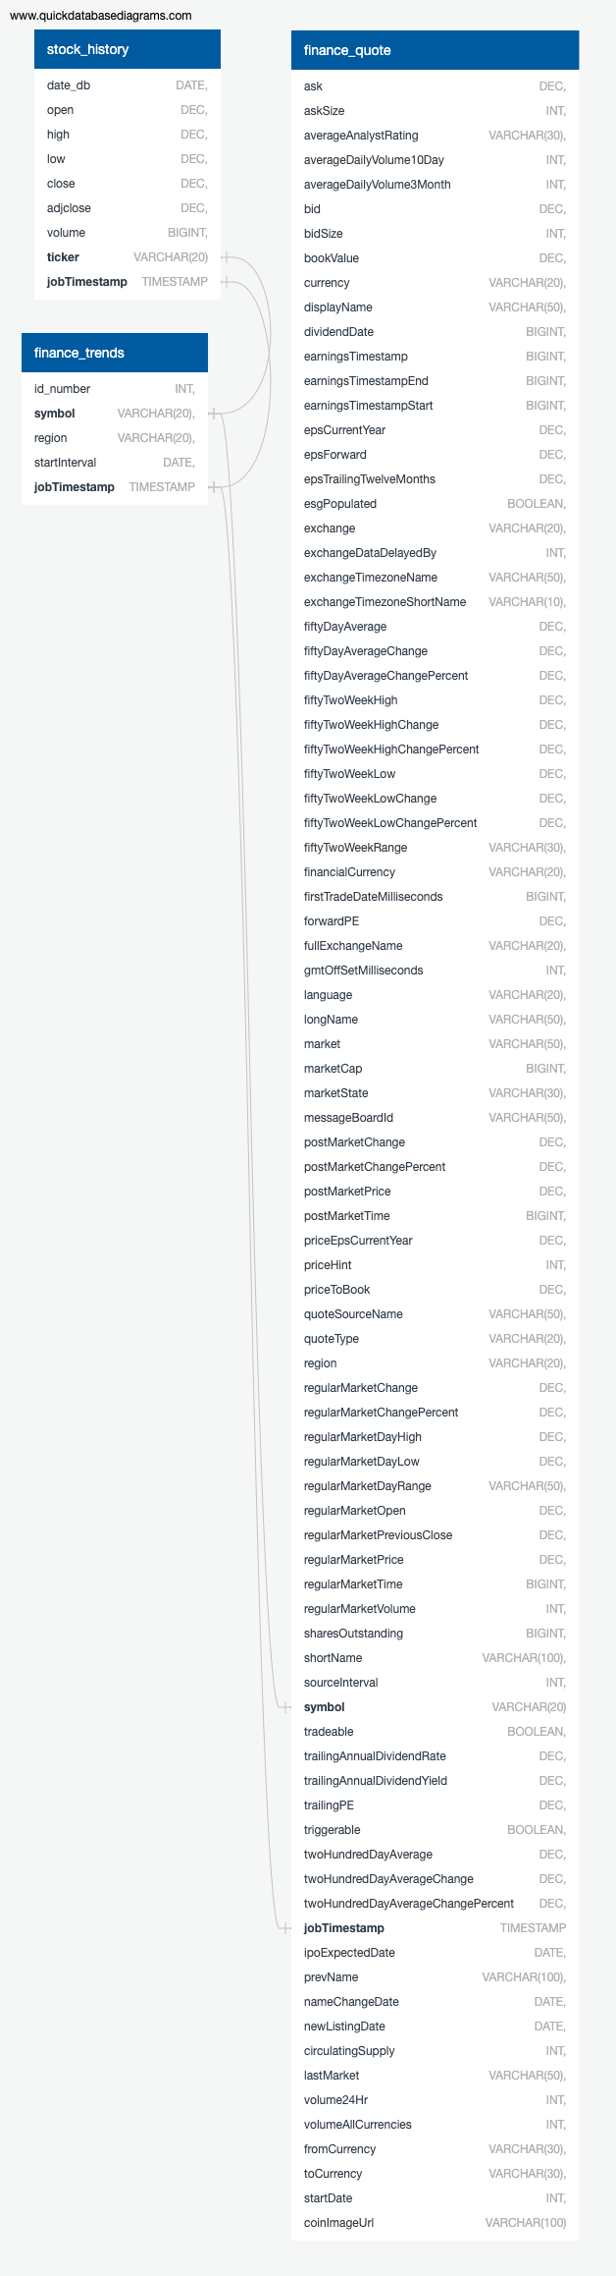
PostgreSQL Tables

Slide 8
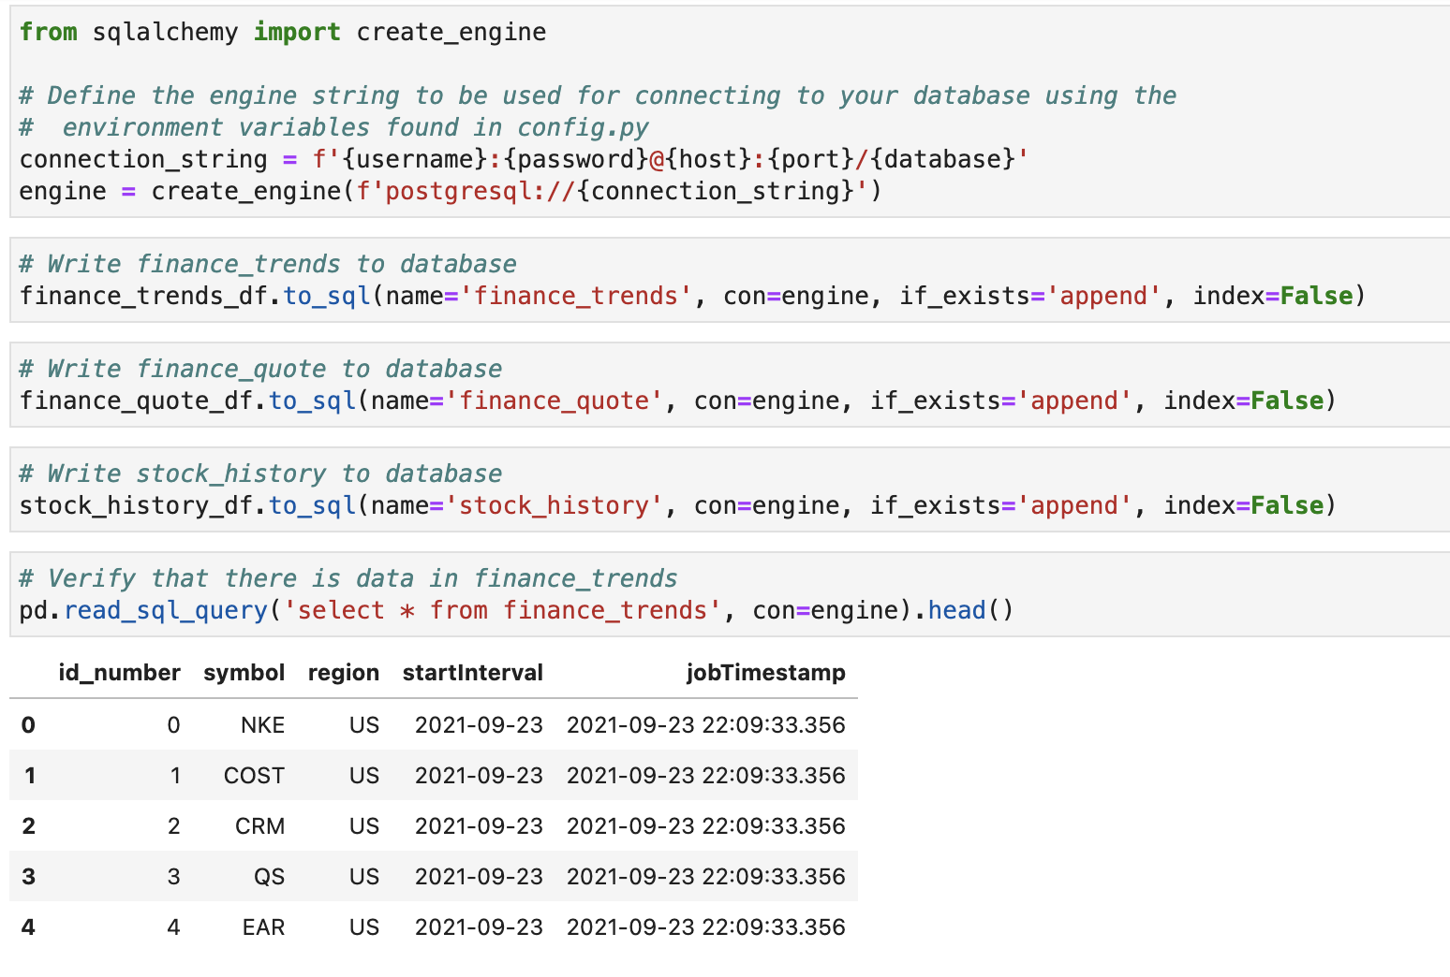
Load Example: DataFrame to PostgreSQL

Slide 9
Challenges
Our main challenges revolved around the APIs we chose to use. We had to learn how they were accessed, how they worked, and what their limitations were. For the quotes API, we could only specify 10 ticker symbols at a time; for the history API we could only specify 1 ticker symbol at a time. For both, we had to run Python 'for' loops to cycle through the varying list of ticker symbols that were trending.
For the open-source library, some ticker symbols were not returning any data and killing the 'for' loop. 'try/except' error handling had to be added to prevent the loop from ending prematurely.
Once the data was decoded into JSON, we had to figure out how to reach the data we sought which was sometimes multiple levels of dictionaries and lists deep.
Our PostgreSQL loading kept requiring us to update our table create SQL statements to compensate for mixed case column names and numeric columns that were not large enough.

Slide 10
What’s Next
Further transform the extracted data in order analyze the data by answering the questions.
Create visualization to further analyze the data.
Review raw data extracted to identify if there are other data points worth analyzing.

Slide 11
THANK YOU!

